Slide 1

Angular Components
Curs 2:

Slide 2
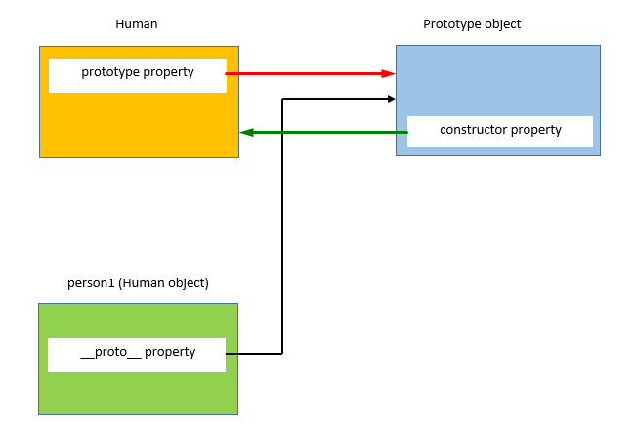
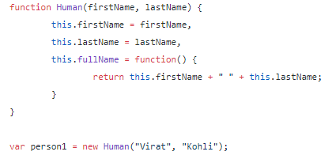
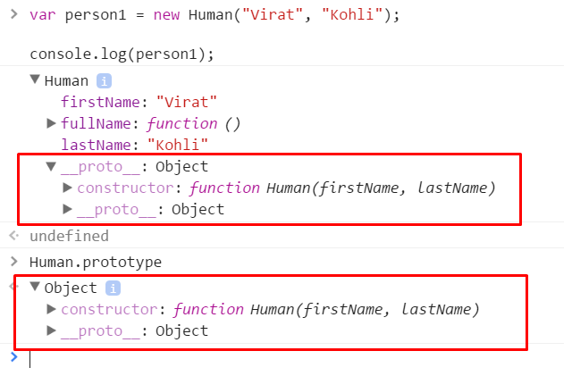
JavaScript Prototype
JS Classes ES5
Prototype is a shared object between classes and objects
Used for identifying and extending objects
Don't change predefined prototypes (Array, Date, etc)!!!

Slide 3
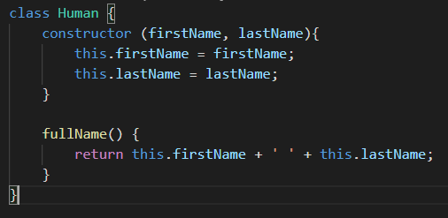
ES6 Classes
ES6 Classes
Same behavior, more close to OOP languages (C#, Java)

Slide 4
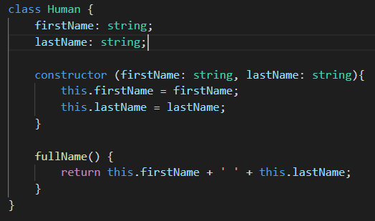
Typescript
Typescript: superset of JavaScript, open-source, developed by Microsoft
Brings variable types and interfaces to JavaScript + extra
Easier to maintain code
Code gets compiled, Compilation errors help find issues faster

Slide 5
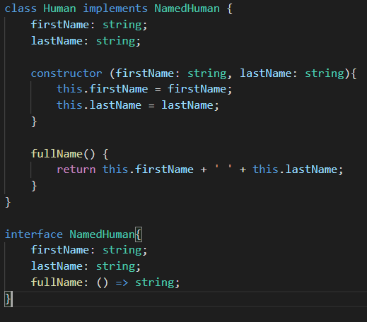
Typescript Interfaces
Doesn't translate to JS
No prototype is assigned to object
Usefull for DTO's
Usefull for imposing behavior for classes

Slide 6
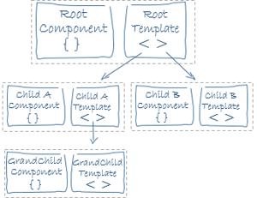
Components
Building block for Angular application
A component controls a patch of screen called a view.
Every Angular Application has an entry component: AppComponent
Structure:
-js class (contains logic for view),
-html template (contains view),
-css (styling for view)
Components are like leafs in a tree:

Slide 7
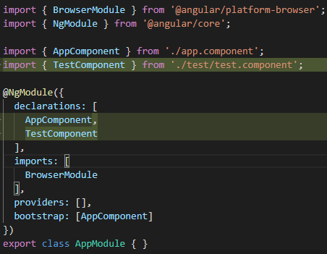
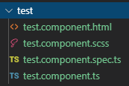
Components
Create a component:
ng generate component MyComponentName
ng g c MyComponentname
Created files:
New components must be specified in app.module under declarations

Slide 8
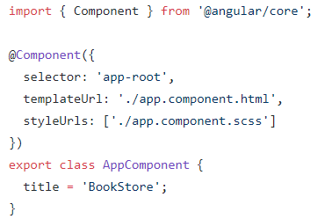
Components
Import different classes and interfaces
@Component decorator specifies the component metadata.
Decorator extends the standard js class, adding extra logic and mapping files
Export – makes component accesible outside the file, can be imported somewhere else

Slide 9
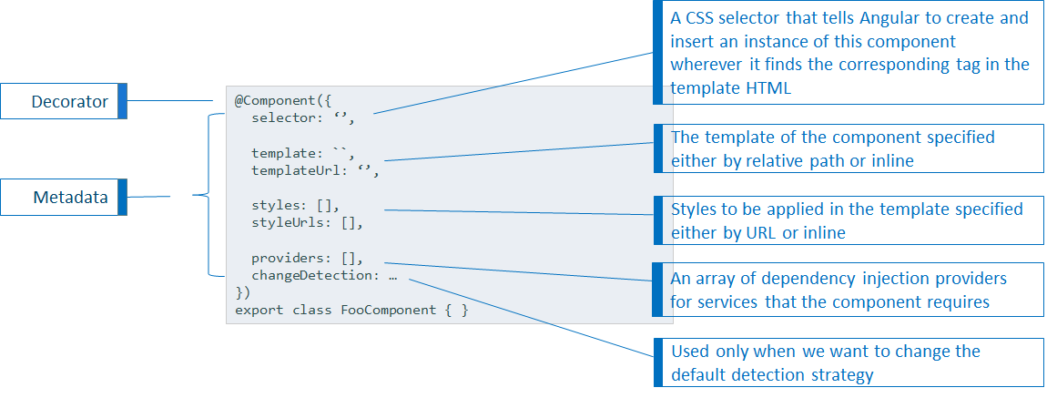
@Component decorator breakdown

Slide 10
Template control
Multiple tools to control component view:
NgIf - if statement in html, condition display of specific content (ex: form validation messages)
NgFor - for statement in html, display same templat for each element of array (ex: list of books)
Interpolation – execute js code in html, restrictive, best practice to use only primitive values
NgSwitch, NgSwitchCase – switch / case statement in html
NgClass – conditioning class presence on template element
NgStyle – conditioning style presence on template element

Slide 11
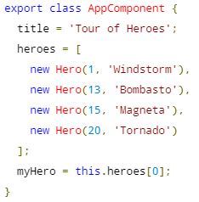
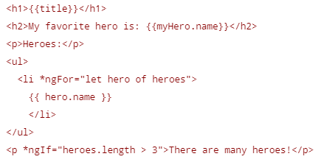
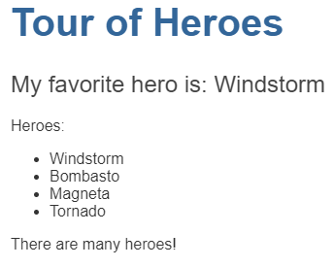
*NgIf, *ngFor and Interpolation

